Slide 1
Big data analytics in the Medical domain Final presentation
Huiran Liu
Roxana Tapia
Oliver Budke
Notes:
–What was the goal of the project?
–What (sub-)tasks had to be solved?
–Which results have you achieved?
–Which tasks could not be solved? Why?

Slide 2
Agenda
Our Project (Poster Draft)
Project Goals
Work-break Down Structure
Implementation Overview
Data Preprocessing
Approach 1
Data Filtering
Feature Extraction
Classification
Approach 2
Data filtering
ARIMA
Checking with the AHE Criteria
Results
Future work
Summary & Questions
Notes:
Our Project (Poster Draft) -- Oliver
Project Goals -- Oliver
Work-break Down Structure -- Oliver
Implementation Overview -- Huiran
Data Preprocessing
Approach 1
Data Filtering
Feature Extraction
Classification
Approach 2
Data filtering
ARIMA
Checking with the AHE Criteria -- Roxana
Results -- Roxana
Future work -- Roxana
Summary & Questions -- Oliver

Slide 3
Big data analytics in the Medical domain
Goal
Implementation Overview
Data Preprocessing
Apporach 1
Apporach 2
Results
Checking with AHE criteria
Future Work

Slide 4
Project Goals
Predict Acute Hypotensive Episode (AHE) in one hour forecast window
Estimate ABPmean for the same forecast window
Real-time analysis of data stream
Visualisation of incoming data
Objectives were NOT
Predict data after the one hour forecast window
Include other parameters than those included in the PhysioNet academic challenges

Slide 5
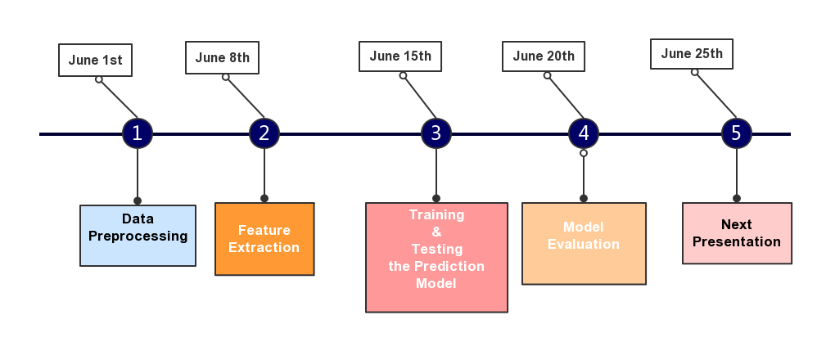
Work-break Down Structure
Understanding the PhysioNet challenge
Retrieve medical background information
Preprocess the data
Convert .dat files
Evaluate methods for Big Data Analytics
Obtain skills with Apache Flink
Visualize training and test data
Research about time series analysis in Java, Python and R
Implement multiple approaches
Compare the results

Slide 6
Work-break Down Structure
Work Items
Feature extraction of 60 patients (H and C) | ☑
Implementation of basic Linear Regression for ABP mean using Sklearn (Python) | ☑
Implementation of Prediction Model based on features | ☑
Export of the Prediction Model into .pmml format | ☒
Import of .pmml model into Flink Prediction Model class | ☒
Model Evaluation based on visualization and Test Set | ☑
Improvements (tentative)
Include other physiological signals in the Linear Regression (e.g. ECG) | ☒
Improve accuracy of Prediction Model (e.g. including data points from ‘segment a’) | ☒

Slide 7
Implementation Overview
AHE classification: 30 different sliding windows within one hour prediction
Question of Eliminating Trend and Season
Online Machine Learning
Batch Learning Algorithm: Random Forest, 50 thousand data points, 100 dimensions -> 10 minutes to execute on a 12 GB RAM machine
Computationally much faster and more space efficient
Usually easier to implement
More difficult to maintain in production
More difficult to evaluate online (no distributional assumption)
Usually more difficult to get “right”

Slide 8

Approach 1
Procedure:
Divide the 600 points of each patient into 2 clusters (above and below the regression line)
Calculate the size above the line (meaningful for predicting AHE)
For each patient we have a vector
< above_mean, below_mean,
above_size >
above
below
Linear regression example in a diabetes dataset
using Sklearn in Python
Features
Labels
$$\left(\begin{matrix}{above_mean}_{1} & {below_mean}_{1} & {above_size}_{1} \\ ⋮ & ⋱ & ⋮ \\ {above_mean}_{60} & {below_mean}_{60} & {above_size}_{60}\end{matrix}\right) × \left[\begin{matrix}0 \\ ⋮ \\ 1\end{matrix}\right]$$

Slide 9
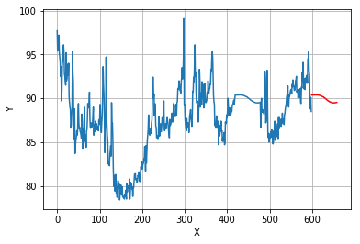
Approach 1 - Feature Extraction
Calculate per average value before 3hours as the value after T0

Slide 10
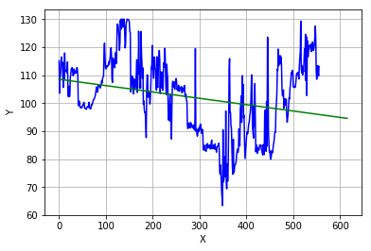
Approach 2
Using Linear Regression to fit the data after T0

Slide 11
Checking with the AHE Criteria
We form a matrix to train our algorithm classify patients from the Training Set records in Python:
Input： The features we extracted in every patient
Labels: AHE in the forecast window occurred or not
(0,1)
Algorithms: SVM, Random Forest
GridSearchCV
CrossValidation for Generalization
Tuning the parameters at same time
Shortcoming: It will take too much time to finish the training process
Save the Model
joblib.dump(model, 'Model.m')

Slide 12
Results
Event 1: Distinguish patients receiving pressor medication
Test set: Set a
Patients belong to the H1 and C1 groups
H1: Patients with AHE in forecast window and pressor medication
C1: Patients without AHE in forecast window and pressor medication
Set size: 10 patients
Expected result: 5 AHE
Study purpose: Find AHE indicators under use of pressors
Event 2: Identify at-risk patients
Test set: Set b
Patients belong to the H(14) and C(26) groups (general)
H: Patients with AHE in forecast window
C: Patients without AHE in forecast window
Set size: 40 patients
Expected result: 10-16 AHE
Study purpose: Show how increased vigilance allows effective intervention in these patients

Slide 13
Results
Prediction on the test dataset A and B
Reading the model and testing
Model=joblib.load(model,’Model.m')
Model.predict(the feacture matrix of test dataset)
Results
AHE patients predicted | Way 1 |  | Way 2 |  | Way 3
 | RF | SVM | RF | SVM | RF | SVM
Test A (5) | 7 | 5 (3) | 4 | 6 | 8 | 6
Test B (10-16) | 17 | 22 (19) | 20 | 24 | 28 | 29

Slide 14
Future Work (1)
Missing data
Nan value in test dataset B
Replace it with 0
Training and testing dataset are too small
Patients | Training | Test A | Test B
C1 | 14 | 5(or 4) | 26
C2 | 14
H1 | 14 | 4(or 5) | 14
H2 | 15
Total | 57 | 9 | 40

Slide 15
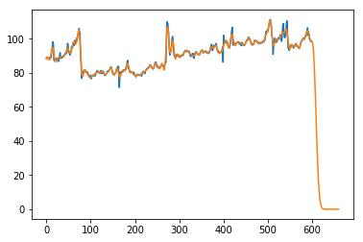
Future Work (2)
General regression algorithm failed to predict
E.g. Kernel Ridge Regression
Possible reasons:
Time series is autocorrelation, which violates independence assumptions.

Slide 16
Future Work (3)
Tuning and find the optimal parameters to improve the accuracy of the model
Try to extend the training dataset
Try to come up with other ways to extract more efficient features of dataset
Time series data with Pandas in Python
Online Machine Learning for streaming data

Slide 17
References
GB Moody, LH Lehman. Predicting acute hypotensive episodes: The 10th Annual PhysioNet/Computers in Cardiology Challenge. 2009.
Blood Pressure definition. Available at: [https://en.wikipedia.org/wiki/Blood_pressure] and [http://www.cvphysiology.com/Blood%20Pressure/BP006]
Receiver operating characteristics. Available at: [https://en.wikipedia.org/wiki/Receiver_operating_characteristic]
Low blood pressure, symptoms and causes. Available at: [https://www.mayoclinic.org/diseases-conditions/low-blood-pressure/symptoms-causes/syc-20355465]
Introduction to Online Machine Learning: Simplified [https://www.analyticsvidhya.com/blog/2015/01/introduction-online-machine-learning-simplified-2/]

Slide 18
Summary & Questions

